Slide 1
Project Team 12: Data Within Education, DS 4200 F20
Taeyoon Jin, Paul Vicks, Haicheng Liu
Presentation
DS 4200 Fall 2020 — Prof. Cody Dunne, Northeastern University

Slide 2
Project motivation
Modern Learning Management Systems (LMS) collect vast amounts of data previously untapped through technology.
Current data visualization techniques falls short at providing detailed data to end users.

Slide 3
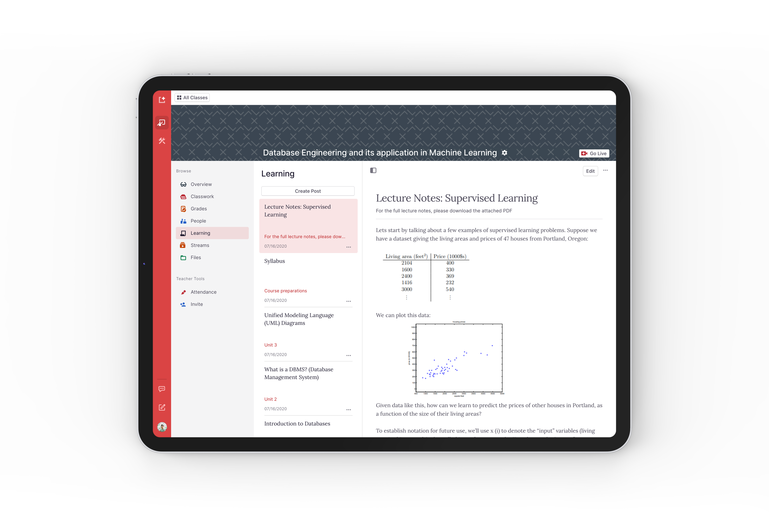
Partner
Keo Plus LMS
Learning management system provider specializing in online education
Data Ranging from Submission Cycles to Student Grades

Slide 4
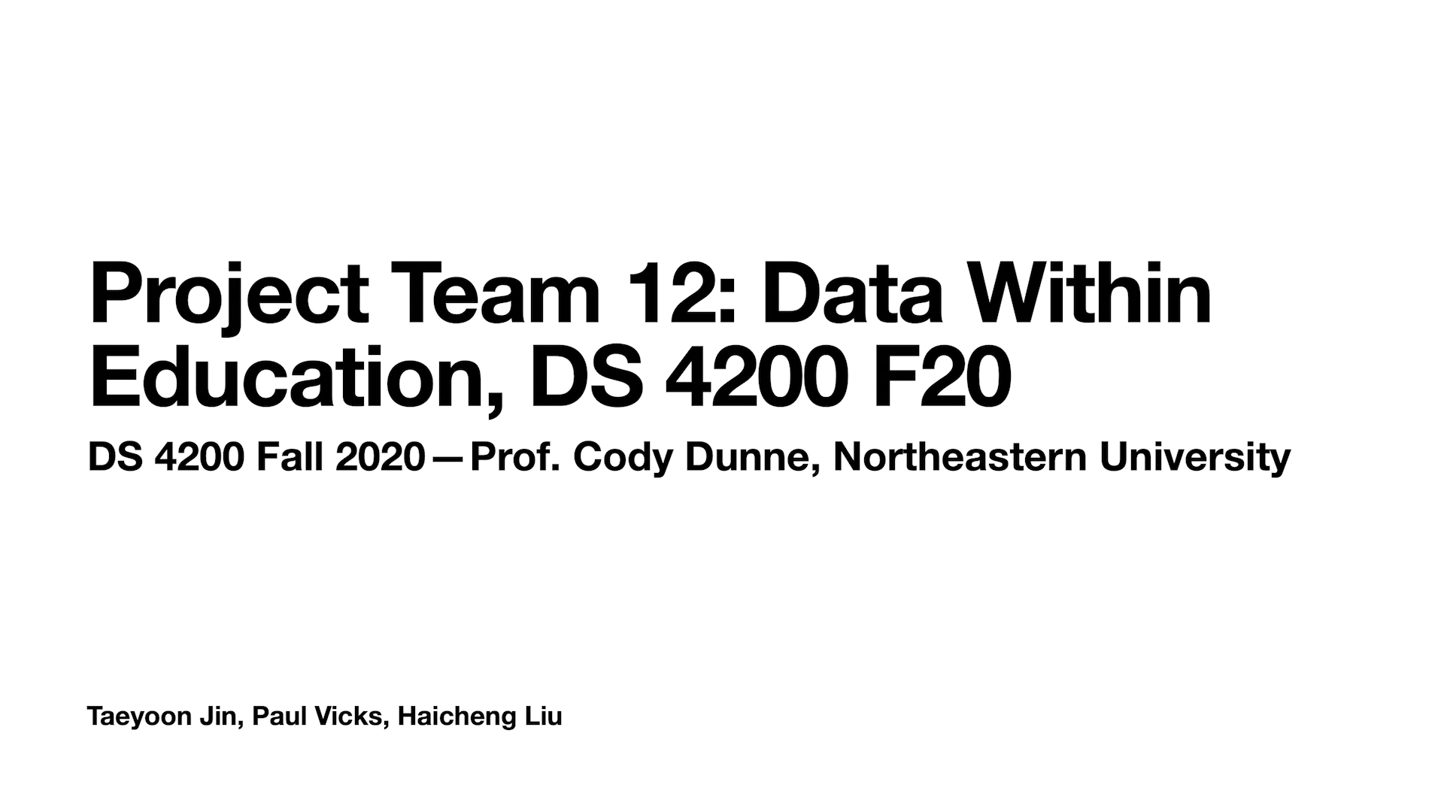
Walkthrough

Slide 5
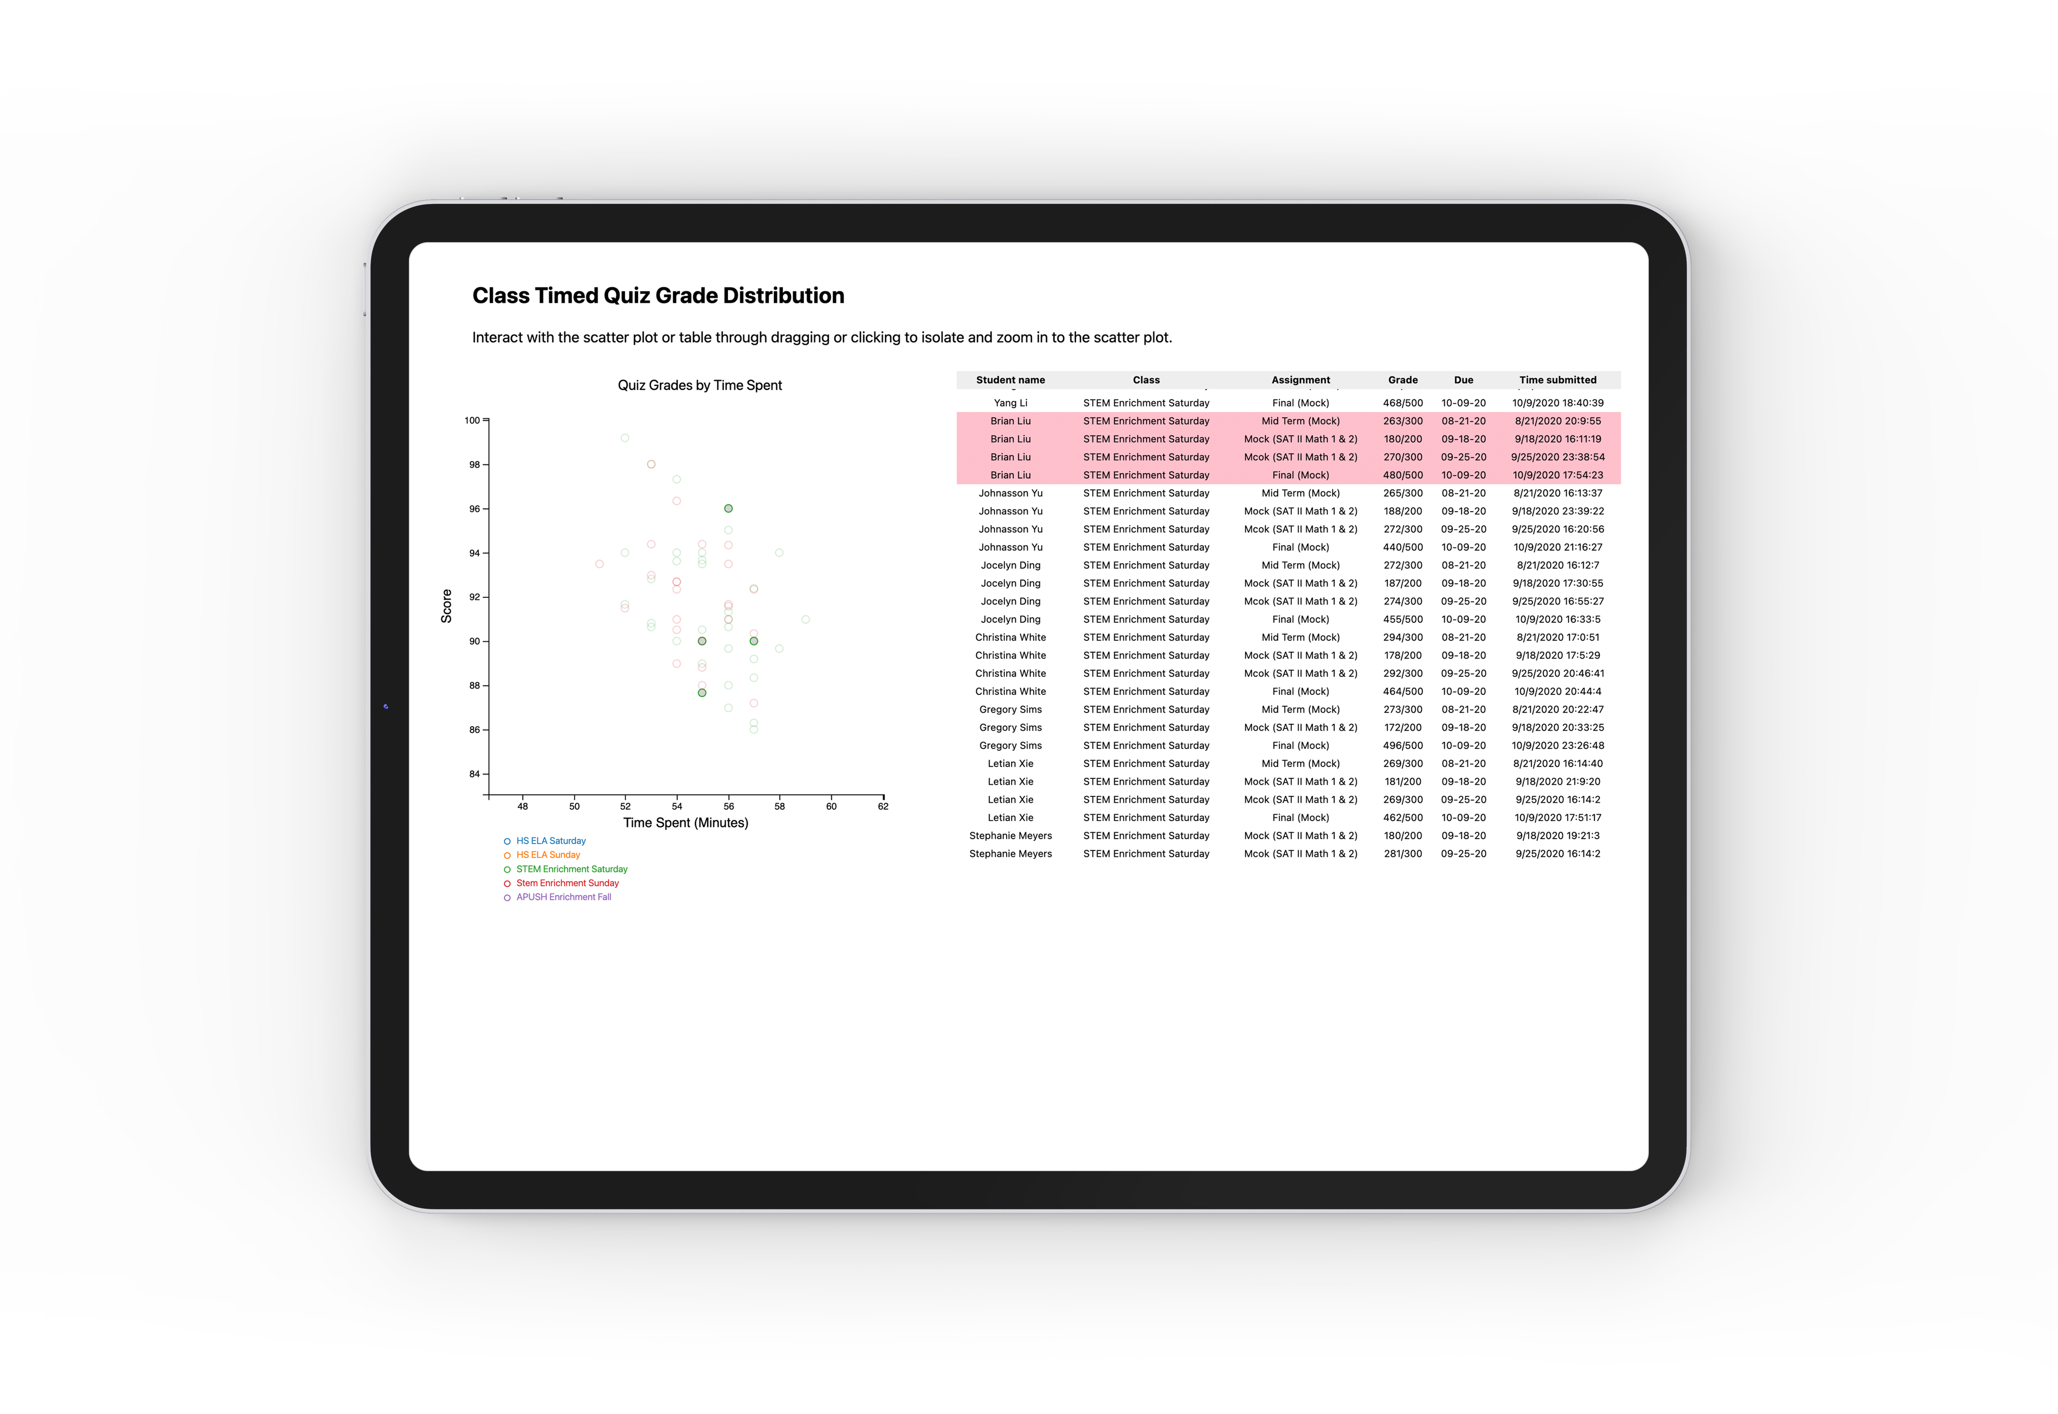
Visualization Design
Table
Scatterplot

Slide 6
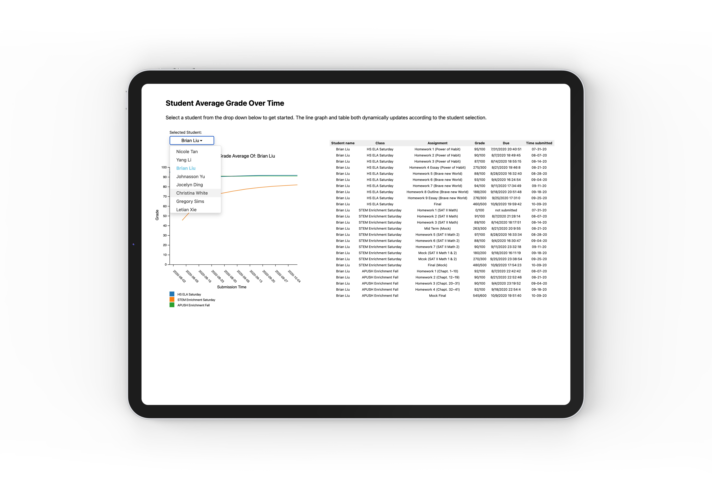
Visualization Design
Table
Linegraph

Slide 7
Summary

